Slide 1
Guy Berger:
Digital Literacy for African Newsrooms:

Slide 2
Coming up …
Do the web!
Monitor hot topics
Multiple home pages
Using RSS
Yahoo pipes
Join communities

Slide 3
1. Do the web
set an example in using Internet-based tools
be the best informed and most organised of all your staff
1

Slide 4
From Web 1 … to Web 2.0
Automation
Database, not separate documents

Slide 5
Complement your pull-searches, by harnessing the Internet’s pushing power.

Slide 6
http://www.google.com/alerts
Push: monitor hot topics
2

Slide 7
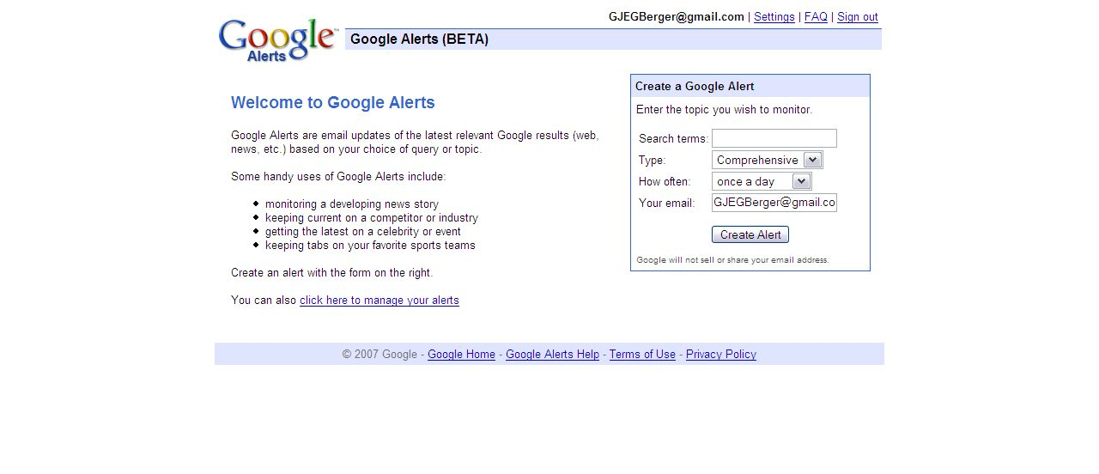

Slide 9
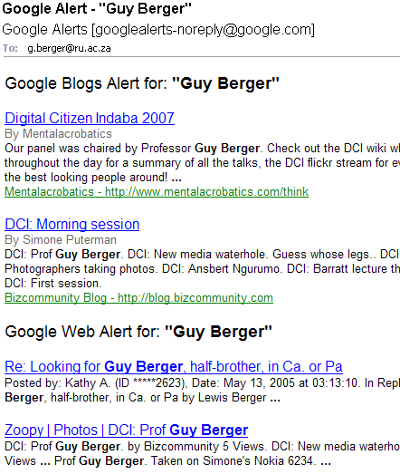
Heh heh!

Slide 10
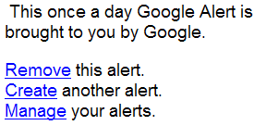

Slide 11
TABS
Push:
Multiple home pages
3

Slide 12
You don’t have to have to load one page, read it, exit, repeat another. Etc etc.
Or even open several NEW windows
TABS = many on the same page.
And SOP get selected ones loading as your default home page settings.
HOW? Browser: tools,options.

Slide 13
RSS feeds: any update at your favourite site comes to you
Push: get fed!
4

Slide 14
3 ways to sign up to RSS feeds:
Via your web browser (eg. Explorer, Firefox) – diverse display
Via your email
Via a dedicated RSS reader (eg. Google reader) (shows in email-style folders)
4i

Slide 15
(i) Via Browser
Explorer
Firefox
click the RSS icon; then click the yellow star on your toolbar; save.
click the RSS icon; click Cntrl D to save; choose bookmarks tool bar

Slide 16
In my view, best for RSS: FIREFOX IT
FIREFOX

Slide 17
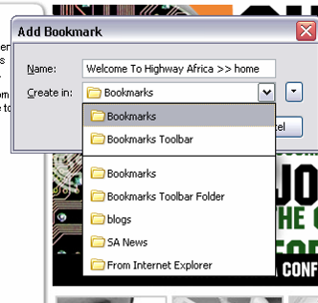

Slide 18
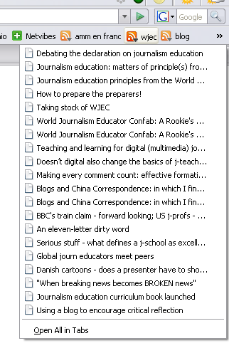

Slide 19
(ii) via Outlook email
EITHER:
RSS Feeds button in your Mail Folders. Right-click there.
OR:
Paste address of feed at www.rssfwd.com

Slide 20
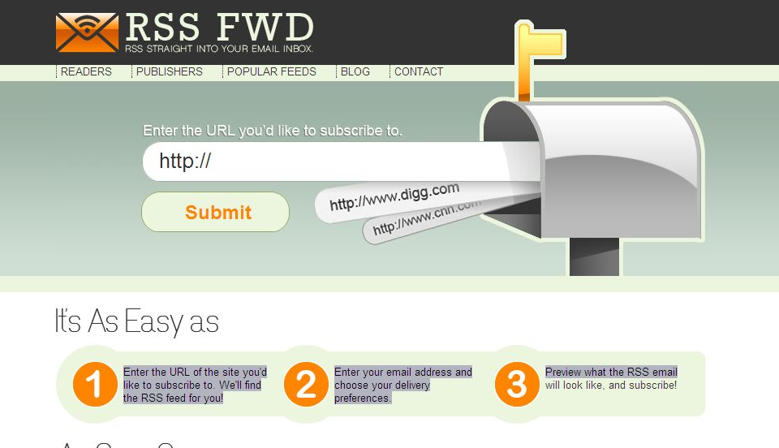

Slide 21
(iii) Via a “reader”
www.google.com/reader
www.newsgator.com Filter for a keyword
www.netvibes.com A one-stop home page?

Slide 22
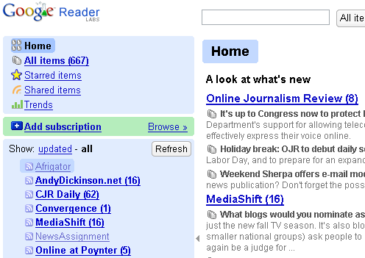

Slide 23
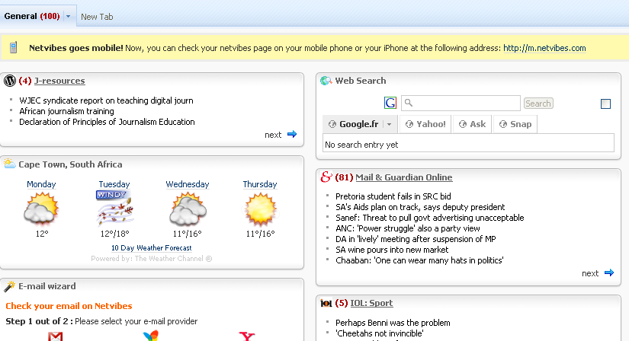

Slide 24
What when an old site doesn’t do RSS?
CONVERT IT!
www.feedity.com

Slide 25
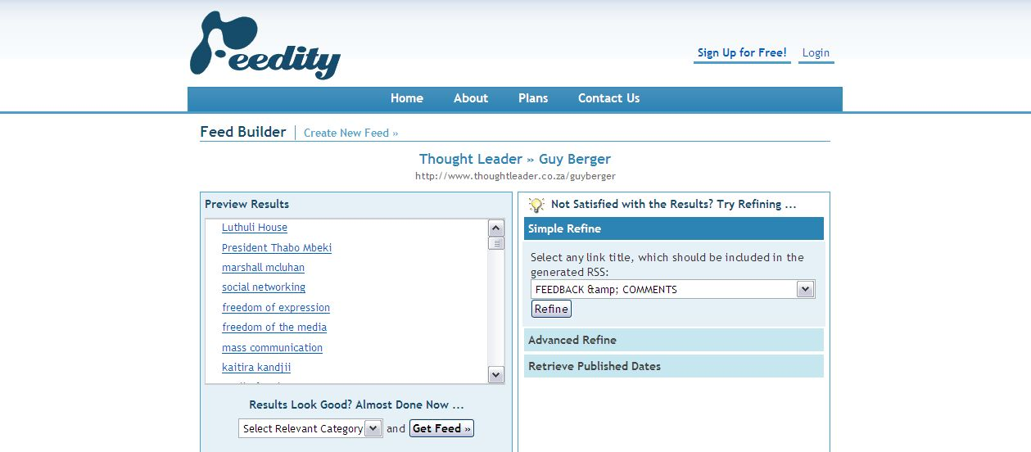

Slide 26
MERGER Plumb for a single funnel
Push yahoo
http://pipes.yahoo.com
4

Slide 27
Aggregate feeds AND filter them!
http://pipes.yahoo.com

Slide 28
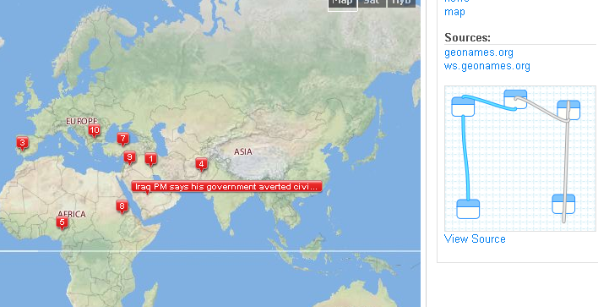

Slide 30
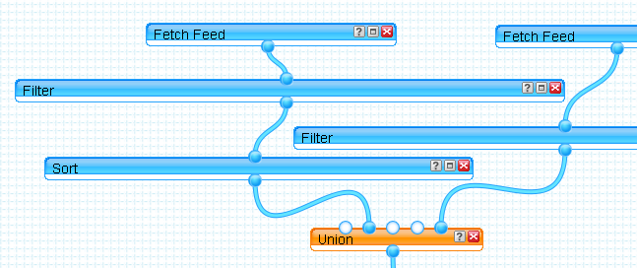

Slide 31
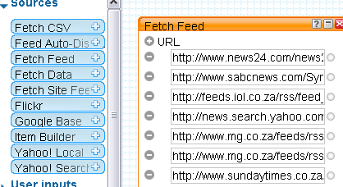

Slide 32
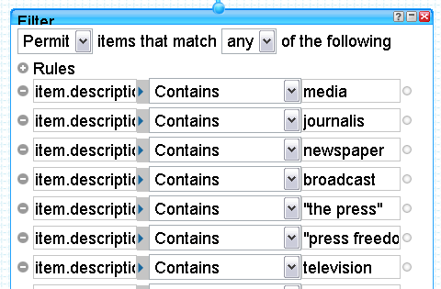

Slide 33
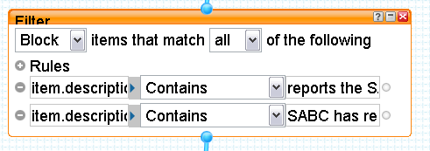

Slide 34
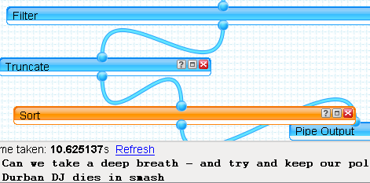

Slide 35
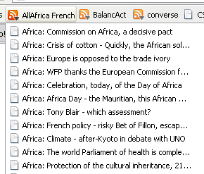
French news translated
Headlines from 41 Francophone Africa news sources!

Slide 36
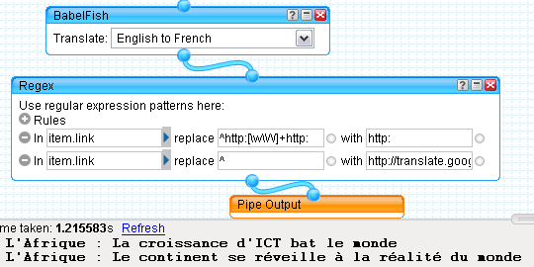

Slide 37
From Web 1 … to Web 2.0
Old way: solo search… or, a pal recommends URL
Surfacing, not searching
Now: communities of interest
5

Slide 38
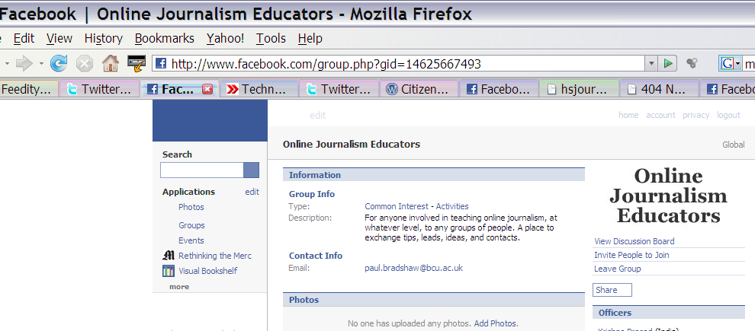

Slide 39
Here’s how…
So: aggregate! eg. tags RSS

Slide 40
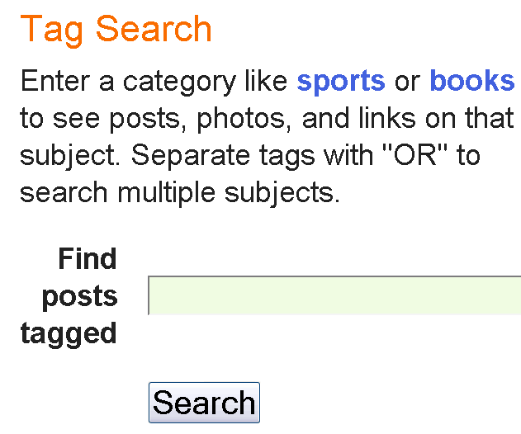

Slide 41
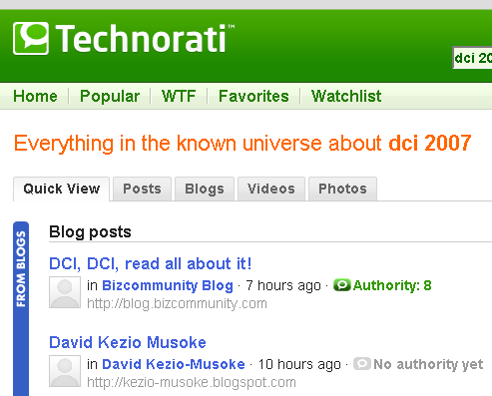

Slide 42
http://feeds.technorati.com/feed/posts/tag/wjec

Slide 43
And try Social Bookmarks:
http://del.icio.us.com
(topic bookmarks to RSS)

Slide 44
So now you know
How to do hot Alerts
Set up multiple home pages
Use RSS (3 options)
Build a Yahoo pipe
Join communities
More?
#

Slide 45
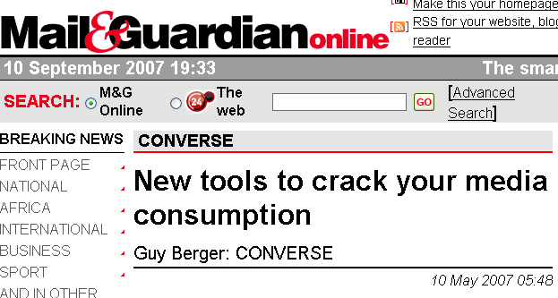
http://www.mg.co.za/converse

Slide 46
Go forth
Get your info … and share the skills
Thank you

